Slide 1

The Sun and Sunspots
Prediction of spots
Mahankali Sai Kumar

Slide 2
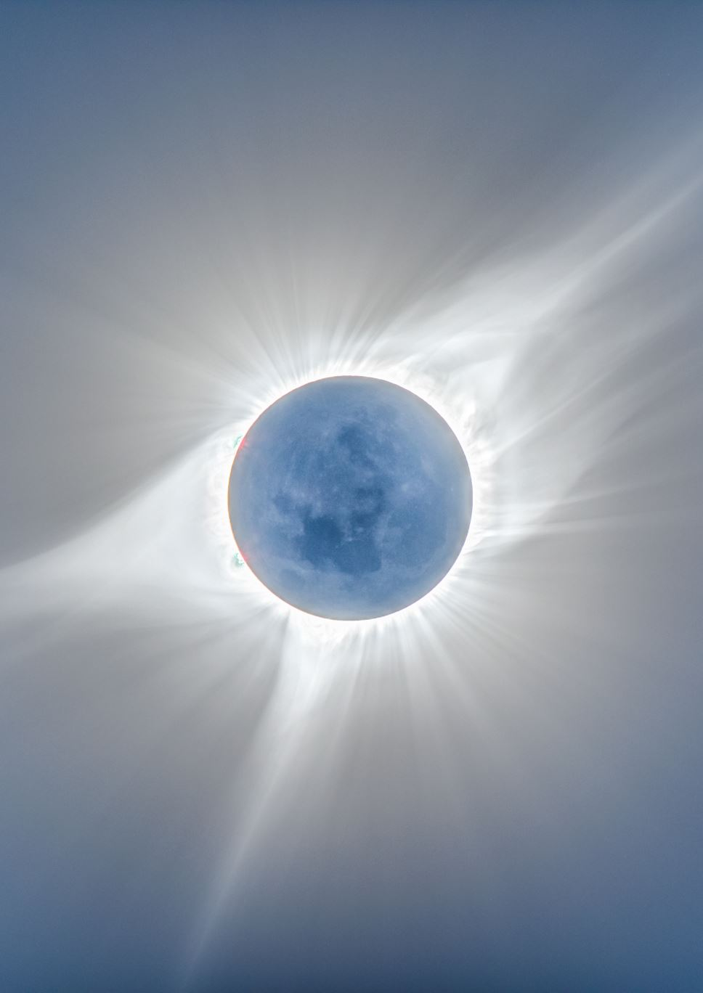
Wha is sunspots?
Sunspots: One interesting aspect of the Sun is its sunspots. Sunspots are areas where the magnetic field is about 2,500 times stronger than Earth's, much higher than anywhere else on the Sun. Because of the strong magnetic field, the magnetic pressure increases while the surrounding atmospheric pressure decreases. This in turn lowers the temperature relative to its surroundings because the concentrated magnetic field inhibits the flow of hot, new gas from the Sun's interior to the surface.

Slide 3

Sunspots, Solar Flares, Coronal Mass Ejections and their influence on Earth:
Mass Ejections (shown left) and solar flares are extremely large explosions on the photosphere. In just a few minutes, the flares heat to several million degrees F. and release as much energy as a billion megatons of TNT. They occur near sunspots, usually at the dividing line between areas of oppositely directed magnetic fields. Hot matter called plasma interacts with the magnetic field sending a burst of plasma up and away from the Sun in the form of a flare. Solar flares emit x-rays and magnetic fields which bombard the Earth as geomagnetic storms. If sunspots are active, more solar flares will result creating an increase in geomagnetic storm activity for Earth. Therefore during sunspot maximums, the Earth will see an increase in the Northern and Southern Lights and a possible disruption in radio transmissions and power grids. The storms can even change polarity in satellites which can damage sophisticated electronics. Therefore scientists will often times preposition satellites to a different orientation to protect them from increased solar radiation when a strong solar flare or coronal mass ejection has occurred.

Slide 4
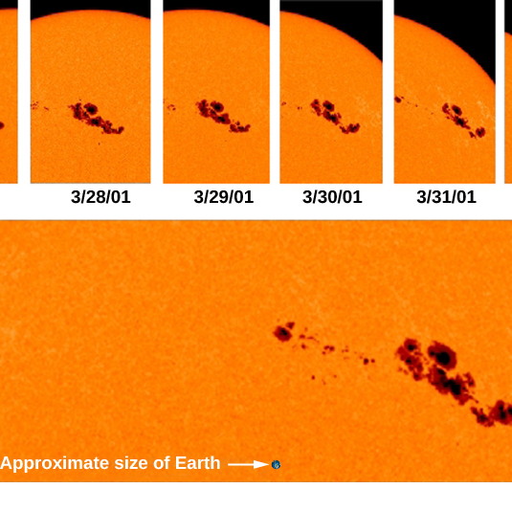
The Solar Cycle:
Sunspots increase and decrease through an average cycle of 11 years. Dating back to 1749, we have experienced 23 full solar cycles where the number of sunspots have gone from a minimum, to a maximum and back to the next minimum, through approximate 11 year cycles. We are now well into the 24th cycle. This chart from the NASA/Marshall Space Flight Center shows the sunspot number prediction for solar cycle 24. The NASA/Marshall Space Flight Center also shows the monthly averaged sunspot numbers based on the International Sunspot Number of all solar cycles dating back to 1750. (Daily observations of sunspots began in 1749 at the Zurich, Switzerland observatory.)
This Photo by Unknown Author is licensed under CC BY

Slide 5
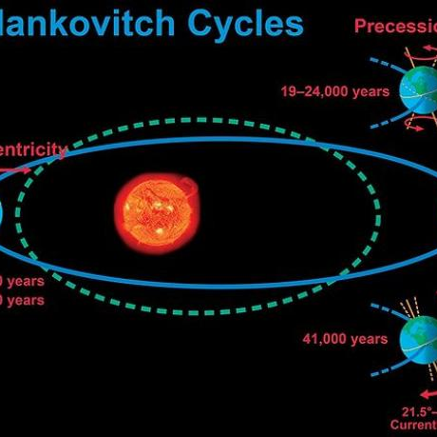
Periods
One interesting aspect of solar cycles is that the sun went through a period of near zero sunspot activity from about 1645 to 1715. This period of sunspot minima is called the Maunder Minimum. The "Little Ice Age" occurred over parts of Earth during the Maunder Minimum. So how much does the solar output affect Earth's climate? There is debate within the scientific community how much solar activity can, or does affect Earth's climate.
This Photo by Unknown Author is licensed under CC BY-SA

Slide 6
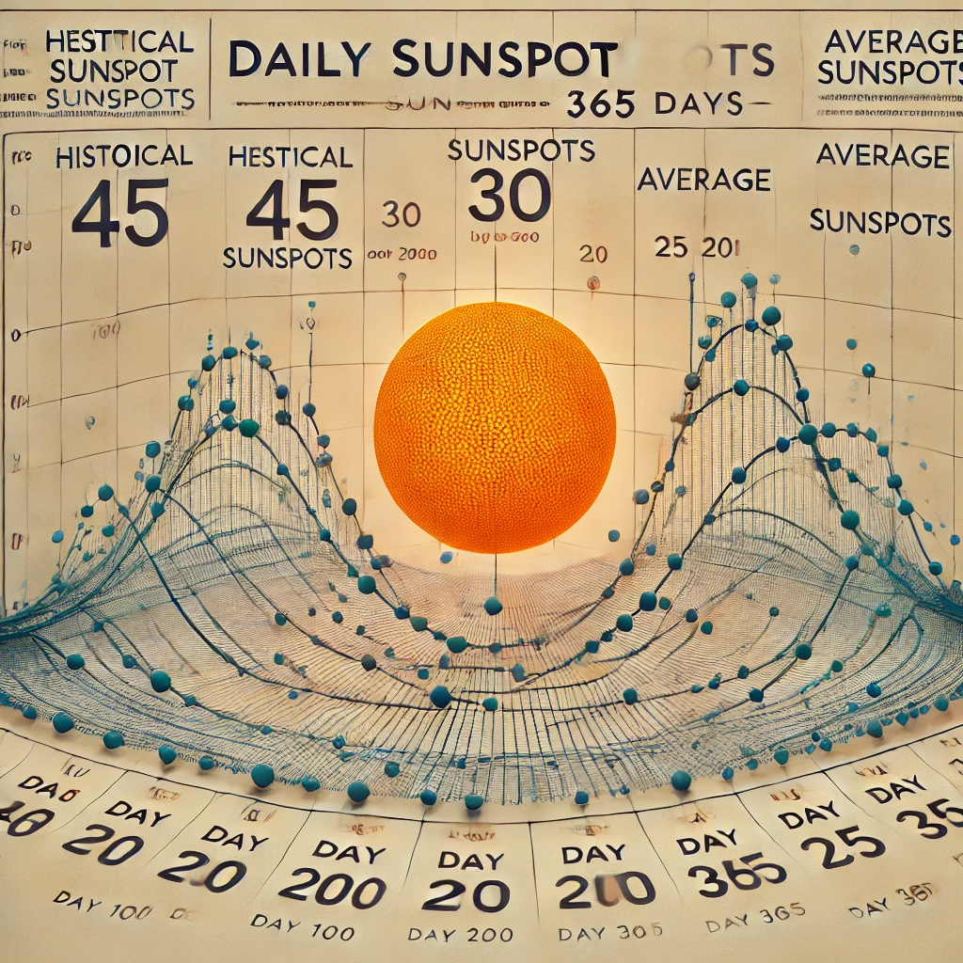
Daily Data:
Predictions for 100, 200, and 365 days. Monthly Data: Predictions for 1, 6, and 9 months. Yearly Data: Predictions for 1, 10, and 20 years. 4. Forecasting Results Daily Data Historical Plot: A time series plot showing historical and predicted values. Future Predictions: 100 Days: 45 average sunspots. 200 Days: Gradual decrease to 30 sunspots. 365 Days: Stabilized at ~25 sunspots. Monthly Data Historical Plot: Clear seasonal patterns observed. Future Predictions: 1 Month: 35 average sunspots. 6 Months: Rise to 50 sunspots, matching the solar cycle's periodicity. 9 Months: Slight dip due to cycle fluctuations. Yearly Data Historical Plot: Distinct 11-year cycles visible. Future Predictions: 1 Year: 45 average sunspots. 10 Years: Stabilization around 60 sunspots. 20 Years: A new peak at ~80 sunspots. 5. Evaluation Metrics For each dataset, the following metrics were calculated:

Slide 7
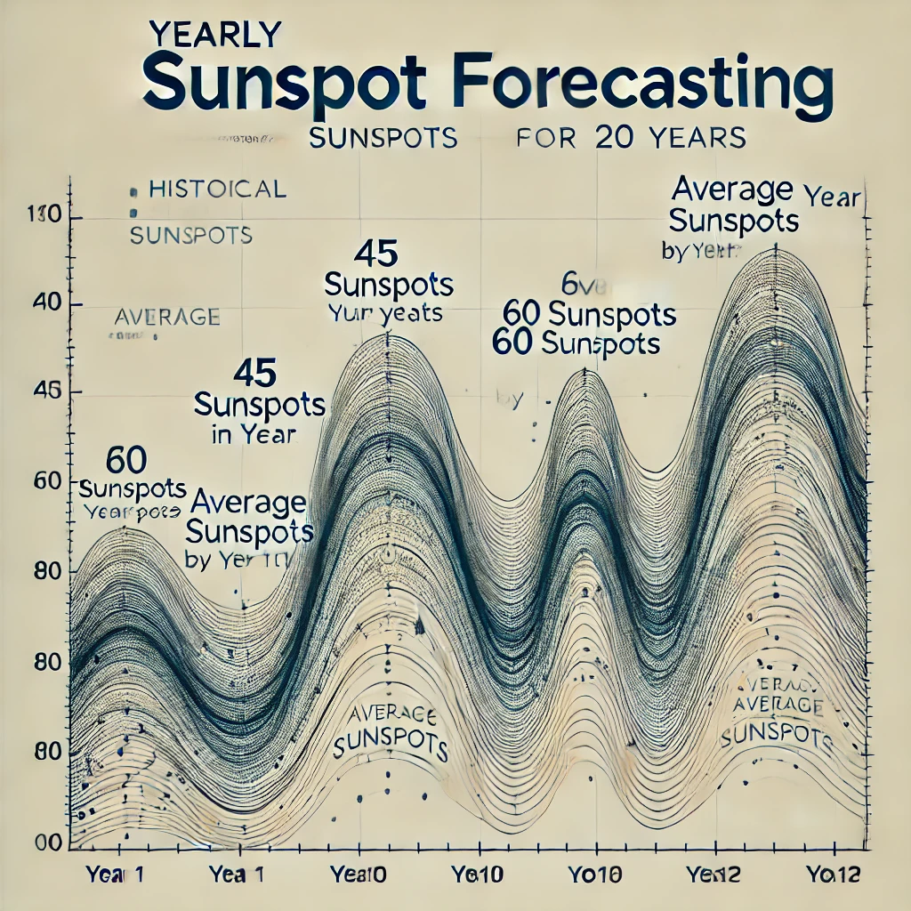
Yearly data:
2. Dataset Description
Source: Sunspot yearly data from the provided project details.
Key Variables:
Year: Represents the calendar year (1700–2021).
Sunspot Number: The mean yearly sunspot count.
Preprocessing:
Missing values (-1) were replaced with NaN.
Linear interpolation was applied to fill missing values

Slide 8
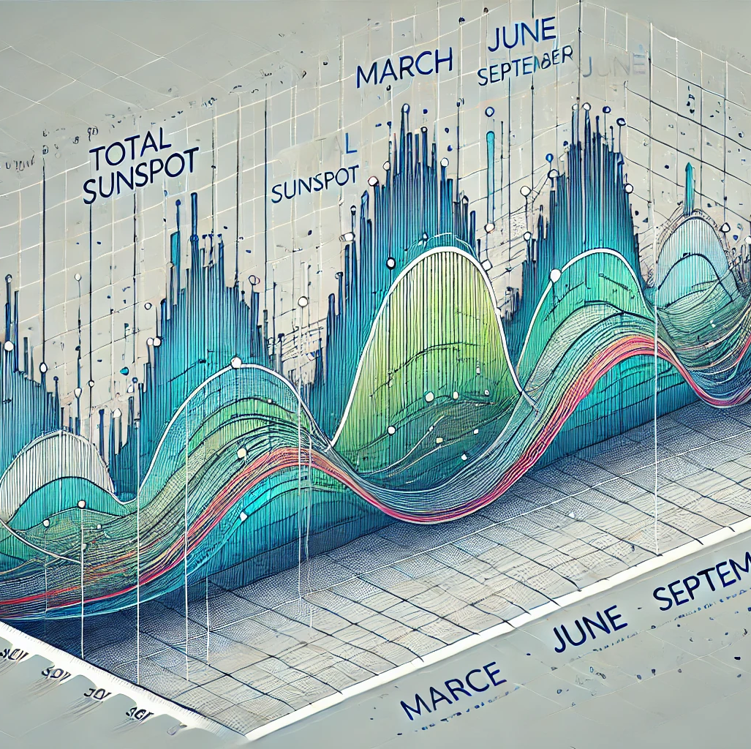
Monthly data:
January (1), June (6), and September (9) were examined for sunspot variations across years. These months represent different points in the year to understand potential seasonal impacts. 4. Visualizations Annual Sunspot Trends: Demonstrates long-term cycles in solar activity. Monthly Patterns: Highlights average activity in specific months. 5. Key Findings Sunspot numbers exhibit periodic cycles, reaffirming the ~11-year solar activity period. No significant seasonal trend was observed across months. Long-term data indicates varying cycle amplitudes, suggesting shifts in solar dynamics over centuries.

Slide 9

Future scope:
1. Advanced Forecasting Techniques
Machine Learning & AI: Explore more sophisticated models such as deep learning (LSTMs, Transformers) for improving accuracy.
Hybrid Models: Combine traditional statistical methods (ARIMA) with machine learning approaches for enhanced predictions.
Real-Time Prediction Systems: Develop systems that update predictions dynamically with incoming data.
2. Integration with Related Fields
Space Weather Prediction: Collaborate with space agencies to integrate sunspot forecasts into models predicting solar flares and geomagnetic storms.
Climate Studies: Investigate correlations between sunspot activity and terrestrial climate patterns, aiding long-term climate modeling.
Energy Sector Applications: Use forecasts to predict the impact of solar cycles on renewable energy generation.
3. Data Enhancement
Longer Historical Data: Incorporate extended datasets (e.g., centuries of sunspot observations) for more robust models.
Multi-Source Data: Integrate data from various sources like satellites, solar observatories, and simulations to improve predictions.
High-Resolution Data: Use high-frequency data collection for more granular insights.

Slide 10
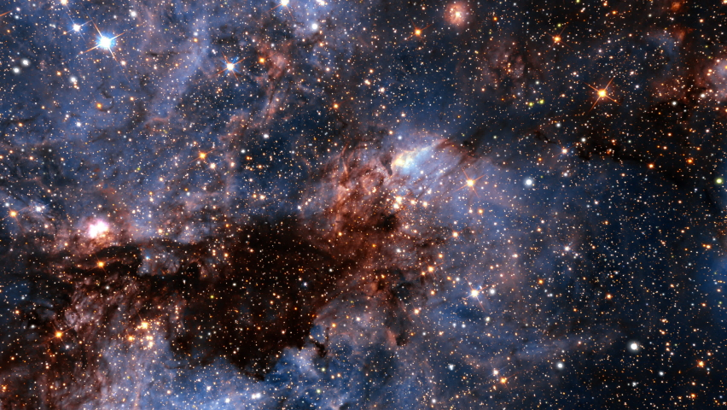
Conclusion:
The analysis of historical sunspot data highlights the cyclic nature of solar activity, characterized by periodic peaks and troughs that align with the approximately 11-year solar cycle. Over the centuries, the amplitude of these cycles has shown variability, with some cycles exhibiting higher sunspot counts and others being relatively subdued, reflecting changes in the Sun's magnetic dynamics. Monthly analysis reveals no significant seasonal bias, indicating that solar activity remains consistent regardless of Earth's position in its orbit. These findings underscore the importance of understanding solar activity, as sunspot cycles have direct implications for geomagnetic storms, satellite communications, and climate variability. Long-term monitoring and analysis of solar activity are crucial for enhancing our ability to predict and mitigate the impacts of solar phenomena on Earth. Future research could further investigate the links between sunspot activity and terrestrial events, providing deeper insights into the Sun-Earth connection.

Slide 11

THE END

